Slide 1

Birth Rates (2007-2021) United States
Benjamin MacDonald
Galvanize: DAI 5
12 July 2023

Slide 2
Data Set
Data originated from the CDC’s WONDER tool
Only factors associated with individual live birth events grouped
Births were grouped by multiple factors (i.e., State, Mother’s Age , Birth Weight)
Data covered a timeline from 2007 to 2021
Limitations: data doesn’t track family size or individual family growth over time
A mother could show up in multiple categories (i.e., Education Level, Mother’s Age at Birth) as time progresses

Slide 3
Initial Questions
Are birth rates declining in the US?
What is the standard range of birth weights in the US today?
Is there a correlation between education level or age of mother to a change in birth rate?

Slide 4
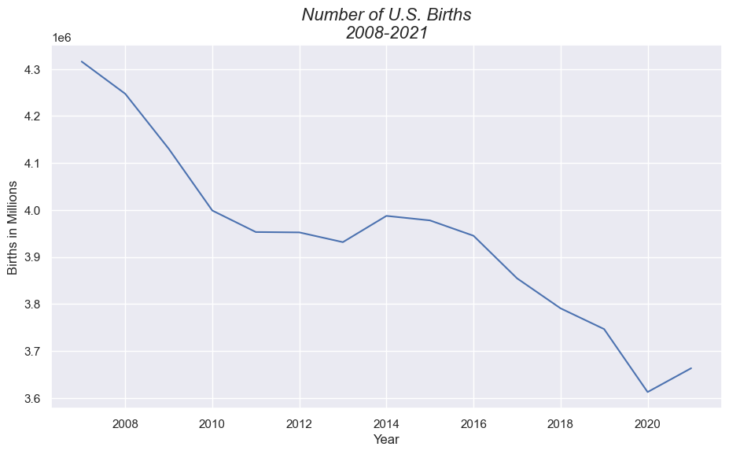
Declining Birth Rates

Slide 5
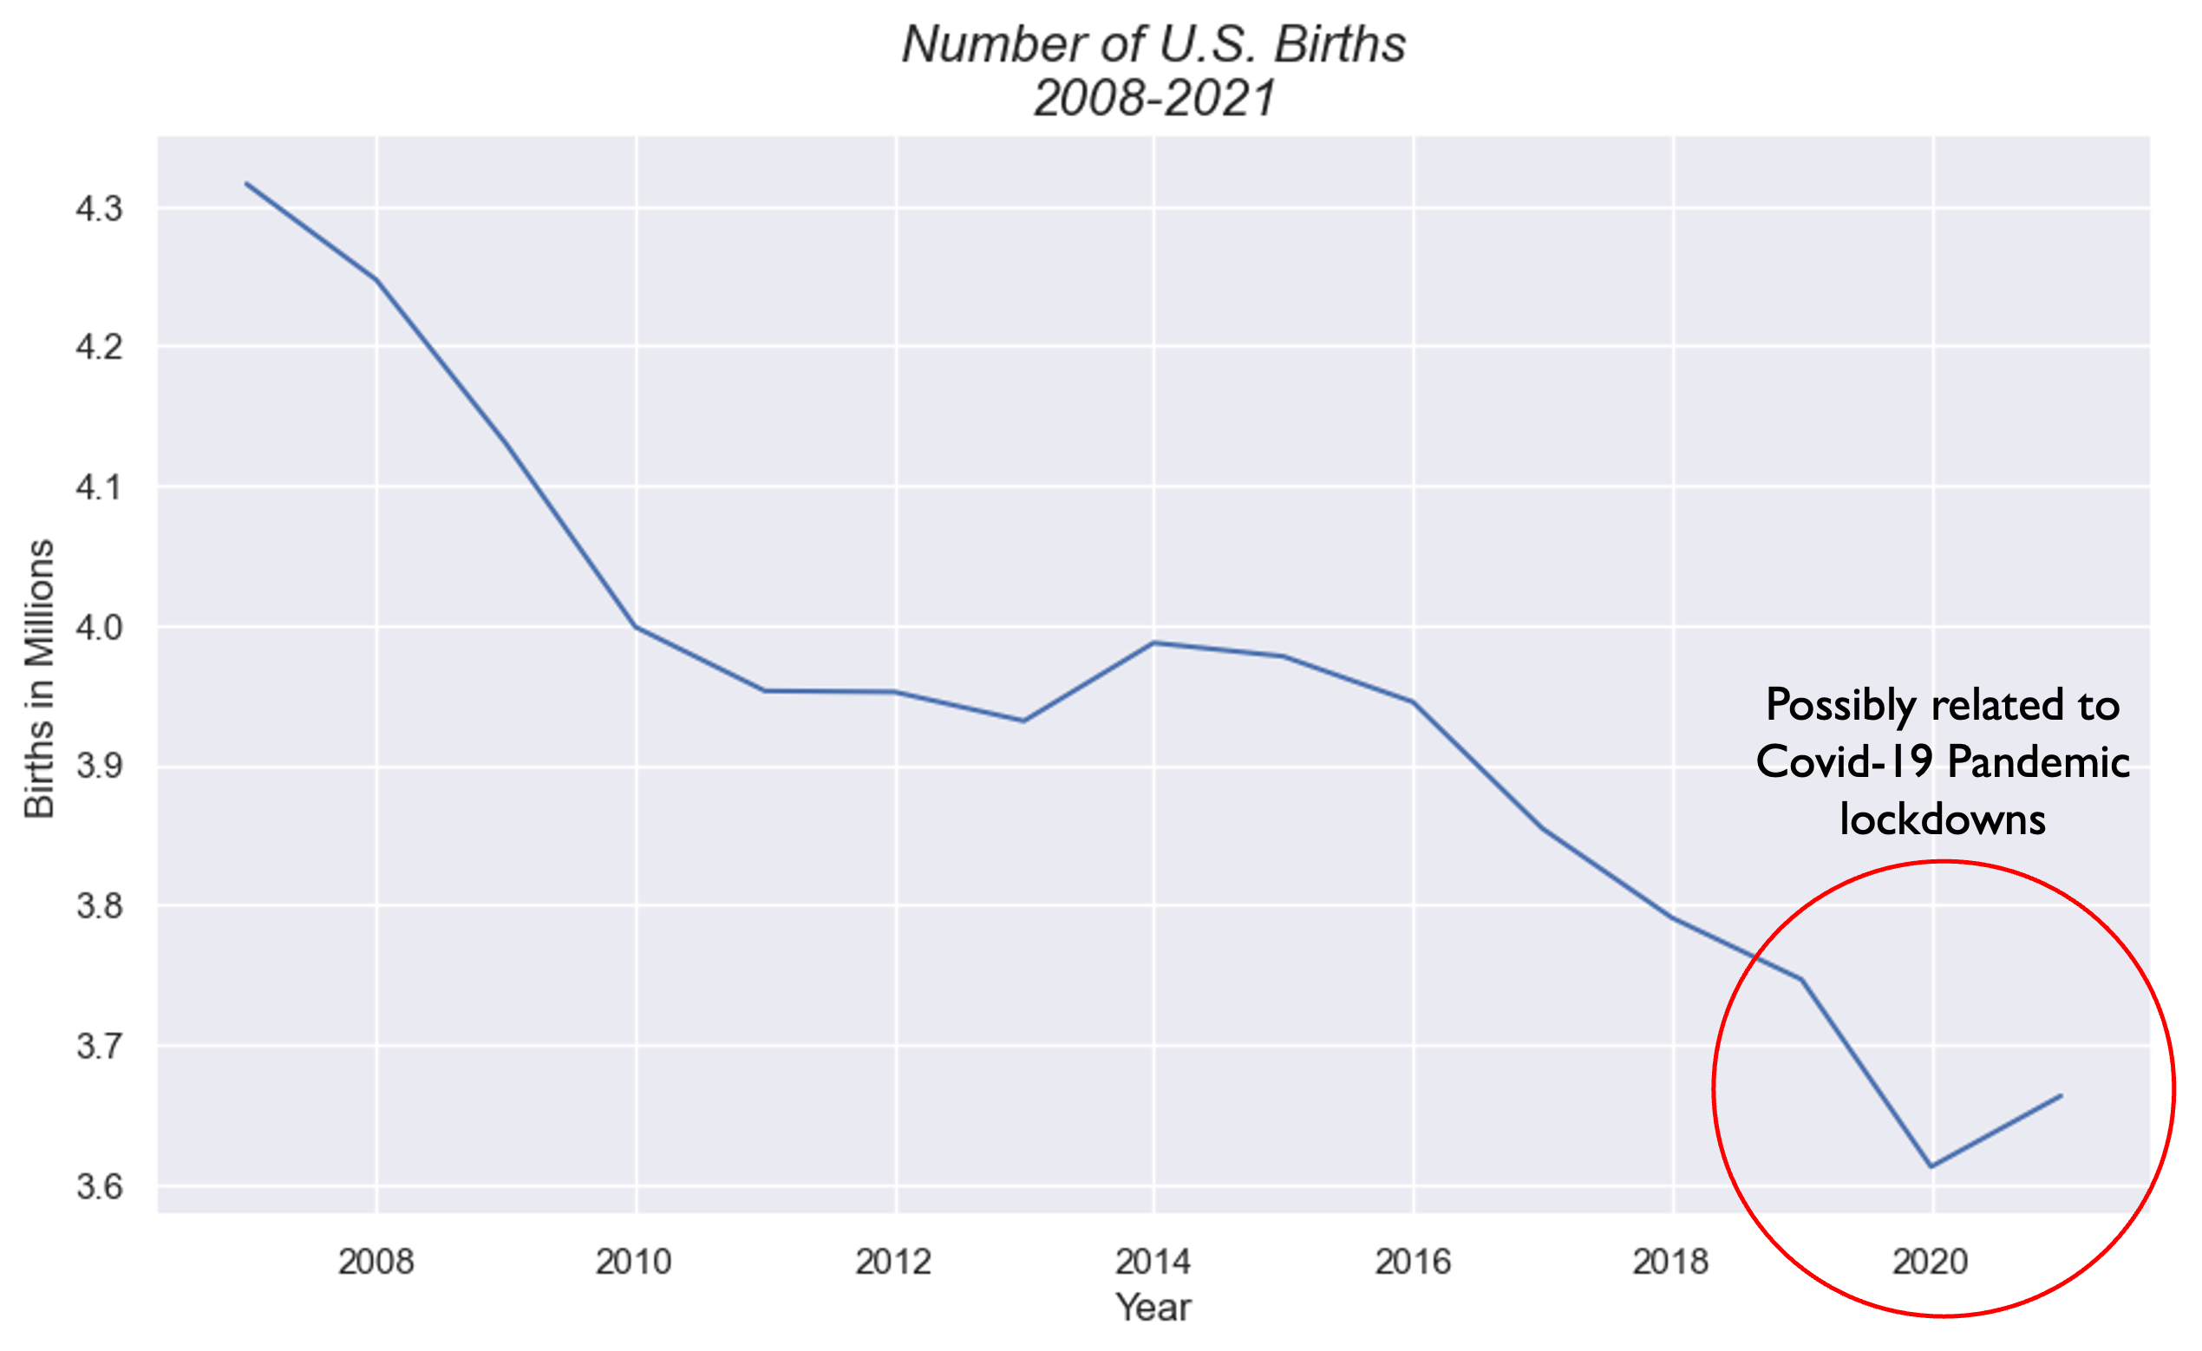
Declining Birth Rates

Slide 6
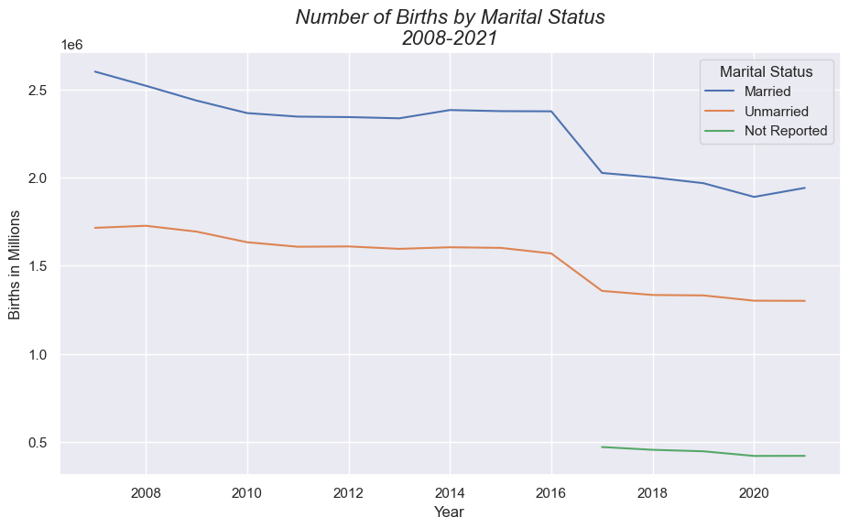
Declining Birth Rates

Slide 7
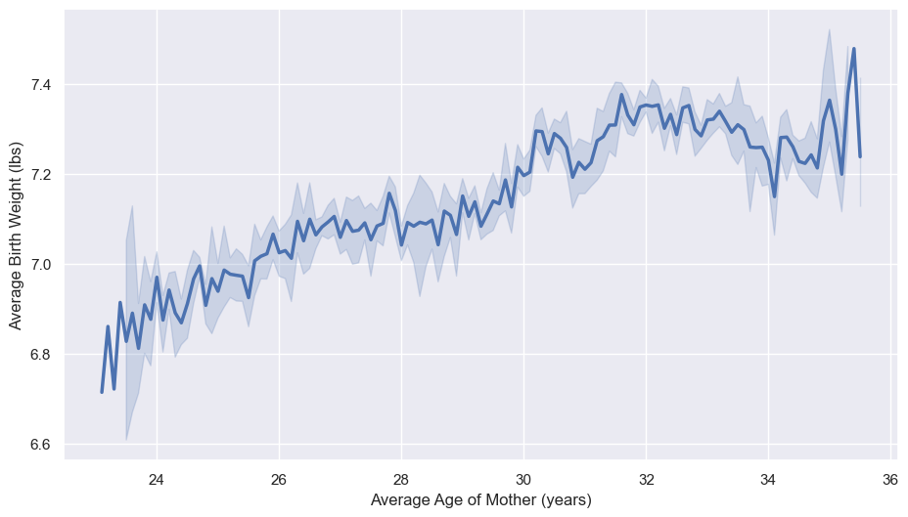
Average Birth Weight in the US

Slide 8
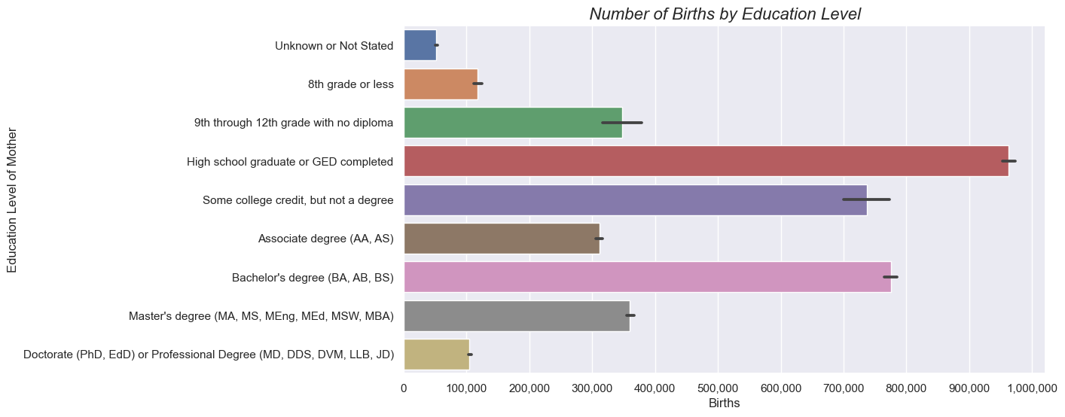
Education Level and Birth rate

Slide 9
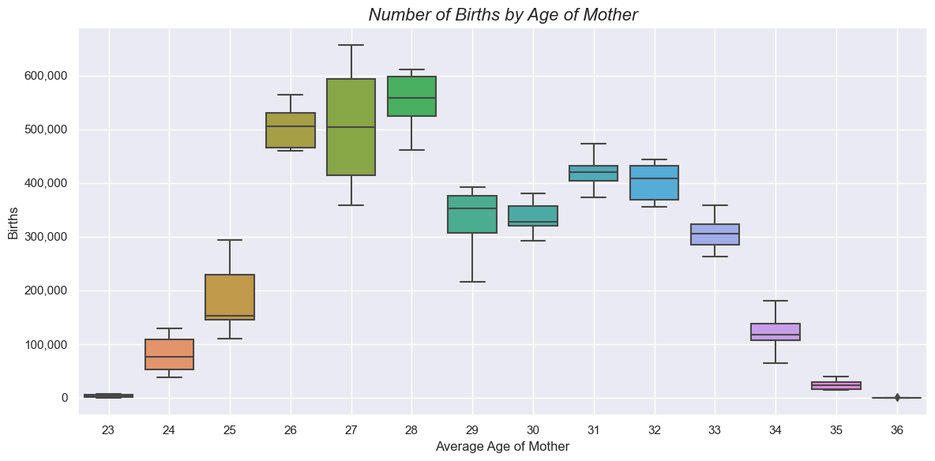
Births distributed by age of mother

Slide 10
Conclusion
Github: https://github.com/b-macd/US-Birth-Rates_analysis
Initial dataset link:
https://www.kaggle.com/datasets/danbraswell/temporary-us-births
Supplemental dataset pulled from:
https://wonder.cdc.gov/natality.html
Contact information:
Benjamin.t.macdonald.mil@army.mil

